Slide 1
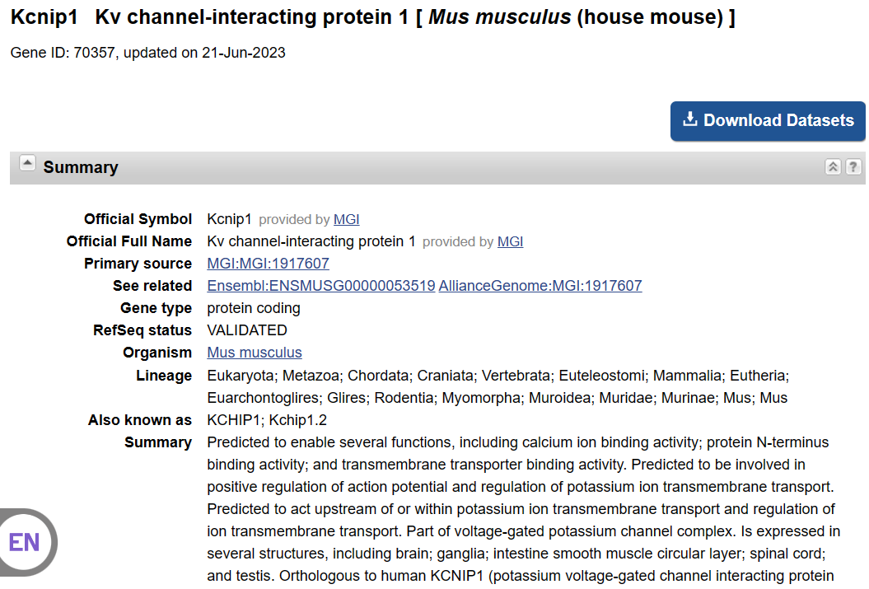
ZT18 vs. ZT6
 | p_val | avg_log2FC | pct.1 | pct.2 | p_val_adj
Kcnip1 | 8.39E-08 | -0.36947 | 0.789 | 0.894 | 0.002925

